Slide 1
TITTLE SLIDE
Project Name: EMBEDDED WEB SERVER
Name: T.Amulya
Intern ID: CITS3856
Duration: 4 weeks

Slide 2
ABSTRACT
The Embedded Web Server project uses the ESP32 microcontroller to host a web page over a Wi-Fi network. The web interface allows users to remotely control an LED using a browser. This project demonstrates wireless communication and Internet of Things (IoT) concepts through a simple and efficient embedded system.
The Project demonstrates the integration of embedded systems with networking technologies to provide wireless control and automation. Due to its low power consumption, built-in Wi-Fi capability, and ease of implementation, the ESP32 is widely used in IoT applications. This project provides a foundation for understanding web server implementation and remote device management in embedded systems.

Slide 3
INTRODUCTION
Embedded systems are specialized computing systems designed to perform dedicated functions. With the advancement of IoT technology, devices can communicate through networks and be controlled remotely. In this project, an ESP32 microcontroller acts as a web server and provides a user-friendly webpage to control an LED through Wi-Fi, eliminating the need for physical switches. In this project, the ESP32 acts as a web server and hosts a webpage containing control buttons for an LED. Users can access this webpage using a smartphone, laptop, or computer connected to the same Wi-Fi network. By clicking the buttons on the webpage, commands are transmitted to the ESP32, which then controls the LED accordingly. This project provides practical knowledge about embedded systems, networking concepts, and IoT applications.

Slide 4
OBJECTIVES
The main objective of the Project is to design and implement an embedded web server using the ESP32 microcontroller for remote control applications. The project aims to establish wireless communication between the ESP32 and users through a web browser. Another objective is to provide a simple and efficient interface for controlling an LED using ON and OFF commands. The project also aims to understand the concepts of embedded systems, Wi-Fi communication, and web server technologies. Furthermore, it helps in gaining practical knowledge of IoT applications and their implementation using modern microcontrollers. The project serves as a basic platform that can be expanded to control multiple devices and sensors in future applications.

Slide 5
COMPONENTS USED
Hardware Required:
ESP32 Development Board
LED
220Ω Resistor
Connecting Wires
Jumper Wires
Software Required:
Arduino IDE
ESP32 WebServer Library
Wi-Fi Library
Wokwi Simulator

Slide 6
METHODOLOGY
Wi-Fi Configuration: The ESP32 is programmed with the SSID and password of the local Wi-Fi network.
Network Connection: After power is supplied, the ESP32 connects to the Wi-Fi network and obtains an IP address.
Web Server Initialization: The ESP32 initializes an embedded web server and starts listening for requests from connected devices.
Web Page Creation: A web page containing LED ON and LED OFF buttons is generated and hosted by the ESP32.
User Access: Users enter the IP address displayed on the Serial Monitor into a web browser to access the control page.
Request Processing: When a button is pressed, the browser sends an HTTP request to the ESP32 web server.

Slide 7
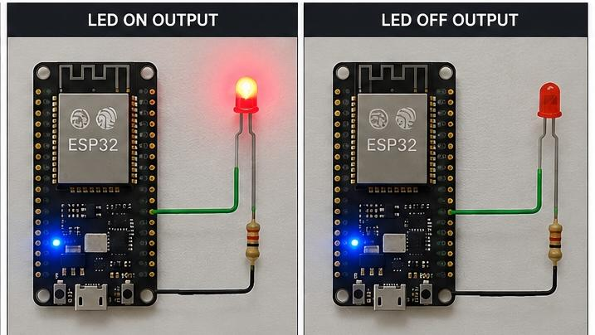
RESULT
The ESP32 connected to the Wi-Fi network and displayed its IP address in the serial monitor. A Webpage was generated succesfully, allowing users to turn the LED ON and OFF remotely. The system operated reliably and demonstrated wireless device control.

Slide 8
ADVANTAGES
Enables wireless control of devices.
Low-cost and energy-efficient solution.
Easy to Implement and maintain.
Supports Internet of Things applications.
Provides real-time monitoring and control.
Can be accessed from any device connected to the network.

Slide 9
APPLICATIONS
Smart Home Automation.
Industrial Monitoring Systems.
Remote Device Control.
IoT-Based Projects.
Smart lighting Systems.
Security and Surveillance Systems.
Educational and Research Applications.

Slide 10
CONCLUSION
The Embedded Web Server using ESP32 was successfully designed and simulated. The system hosts a webpage through Wi-Fi and enables users to control an LED remotely. The project demonstrates the practical implementation of embedded systems and IoT technologies, providing a foundation for advanced smart applications.The developed system can serve as a basic framework for more advanced Internet of Things applications. The project can be extended to home automation, industrial monitoring, smart agriculture, healthcare systems, and remote data acquisition applications.The knowledge gained through this project provides a strong foundation for designing and implementing future IoT-based automation solutions.

